Slide 1
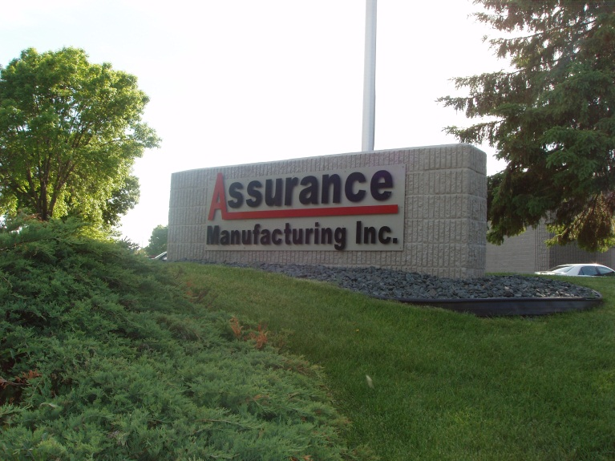
“Assurance Manufacturing, Inc. and its employees are committed to providing our customers with quality products that will meet or exceed their requirements.
This drive for excellence in quality and customer service enables us to continually improve the effectiveness of the quality management system.”
Notes:
All font on slides Arial Narrow in 22 size.

Slide 2
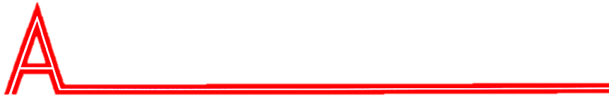
History/Vision
SSURANCE MANUFACTURING, INC.

Slide 3
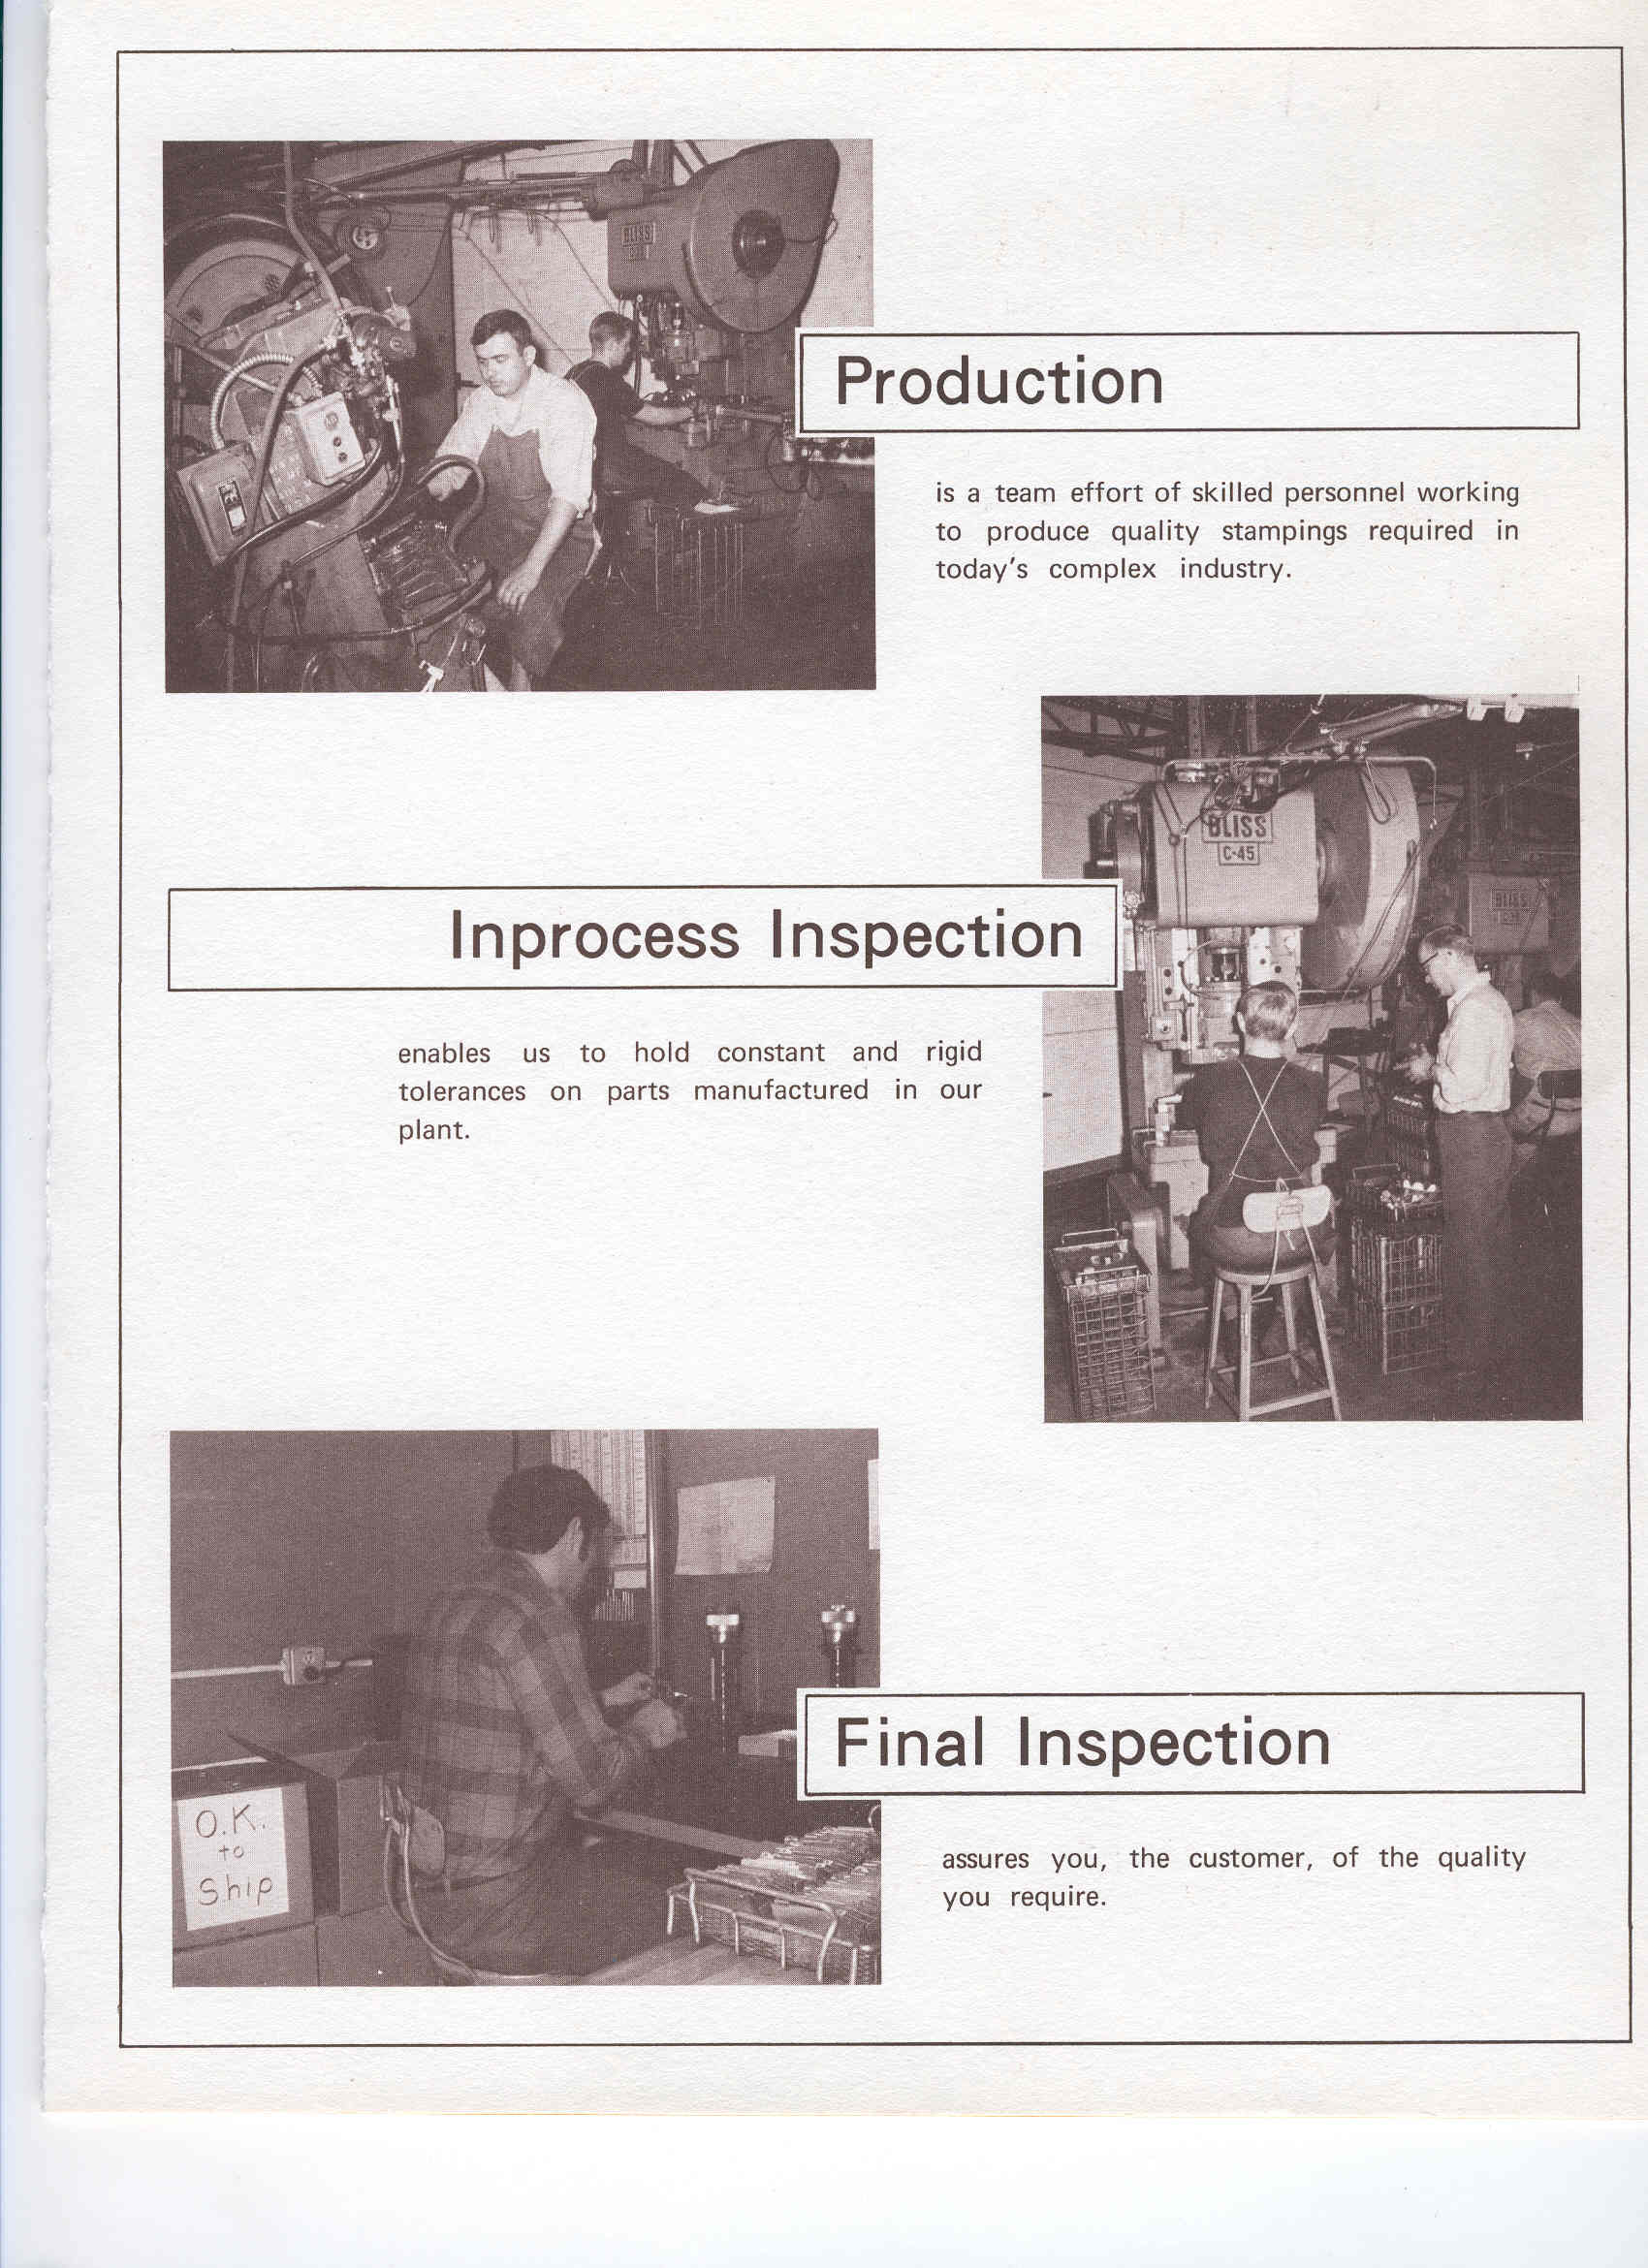
SSURANCE MANUFACTURING, INC.
Founded in 1966
Started as a simple tool and die shop and now a full one stop shop for precision sheet metal, stampings, machining, and value-added assembly.
Customer focus was the vision then and still is today

Slide 4
In 1993 the company was converted into a 100% ESOP owned company
“We take pride as owners”
Anonymous employee of Assurance
SSURANCE MANUFACTURING, INC.
Ownership
Stock
Employee
Assurance stock performance

Slide 5
Capabilities
SSURANCE MANUFACTURING, INC.

Slide 6
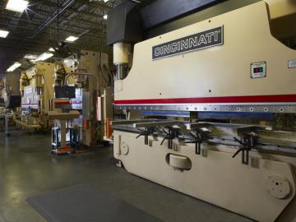
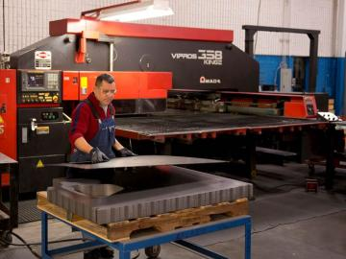
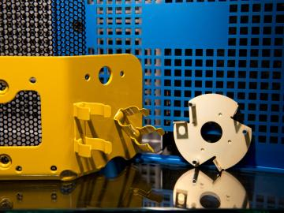
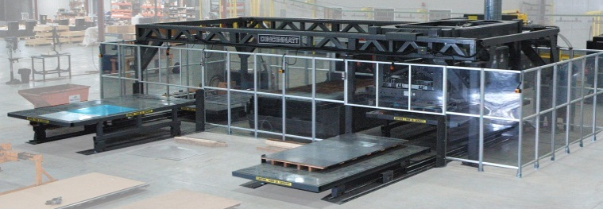
SSURANCE MANUFACTURING, INC.
Precision Sheet Metal Fabrication
  6 Turret Presses
  1 Turret/Laser Combo
  3 Lasers
  “Lights Out” Laser Cutting
  12 Press Brakes
Turret/Laser Combo

Slide 7
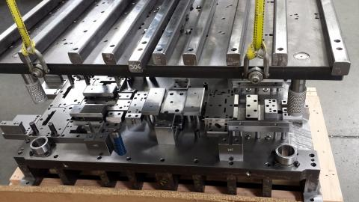
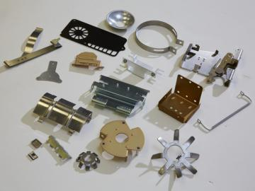
SSURANCE MANUFACTURING, INC.
Precision Stamping
  51 Presses
  6 Press Lines
  Stage and Progressive Capabilities
  In-house tooling
  Range of 20-250 Tons

Slide 8
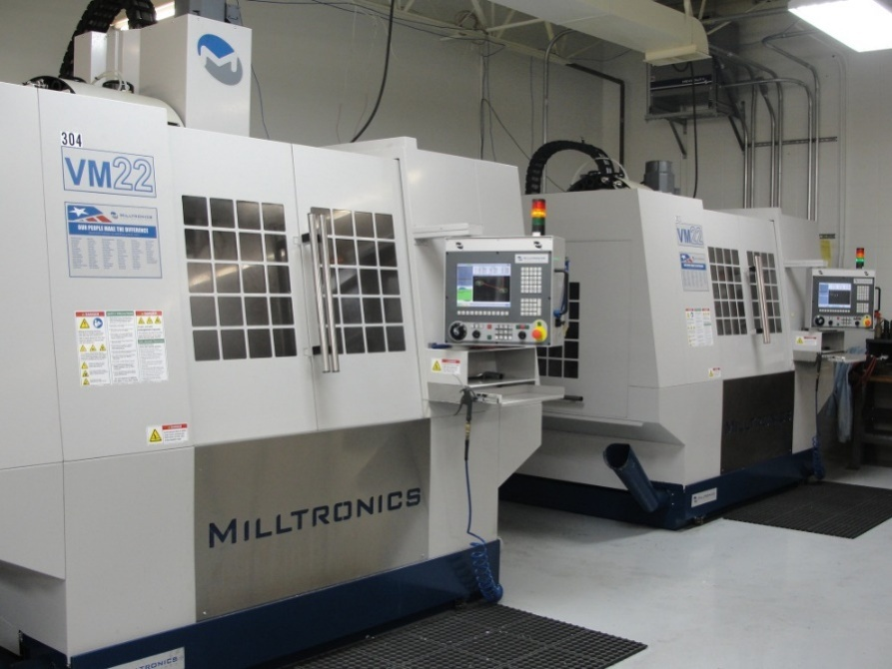
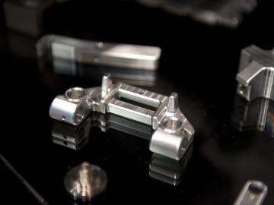
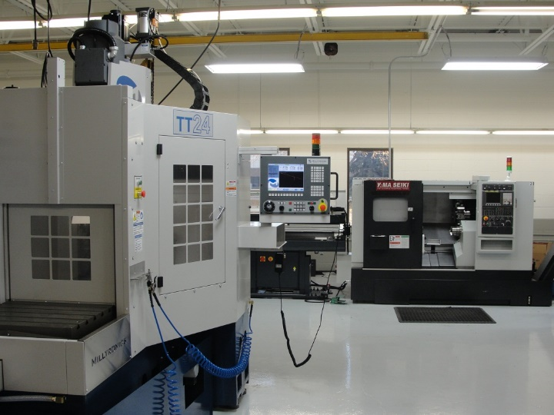
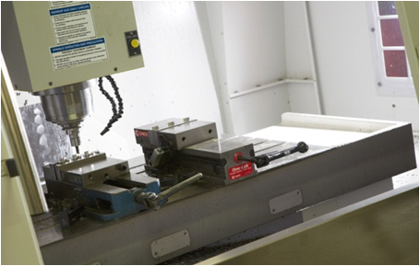
Precision Machining
  CNC Milling
  CNC Turning
SSURANCE MANUFACTURING, INC.

Slide 9
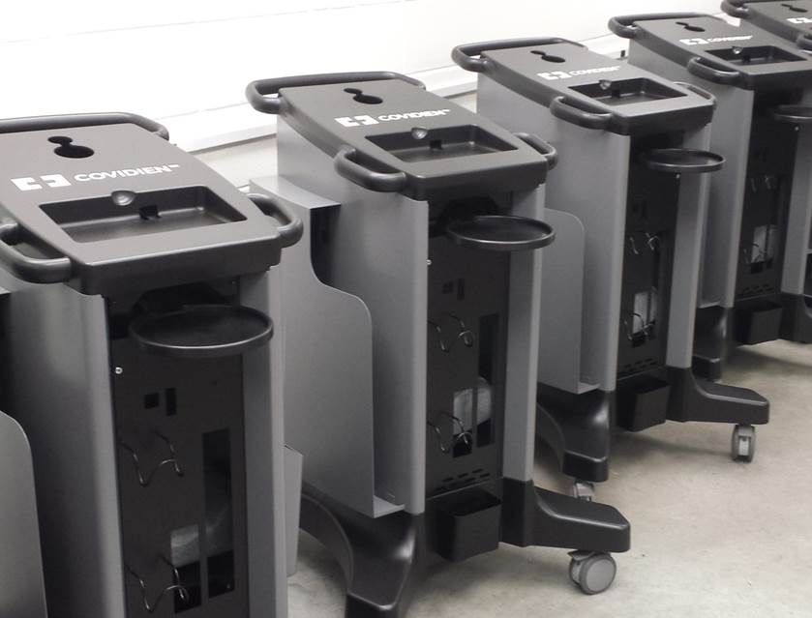
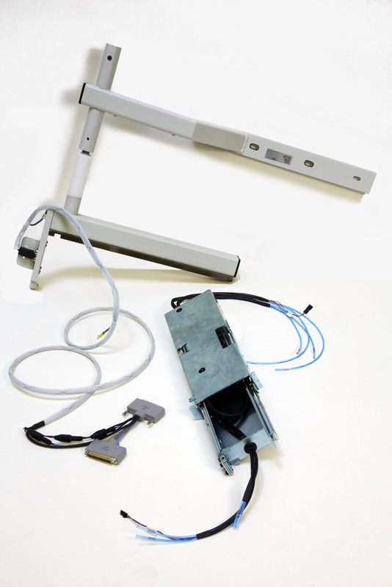
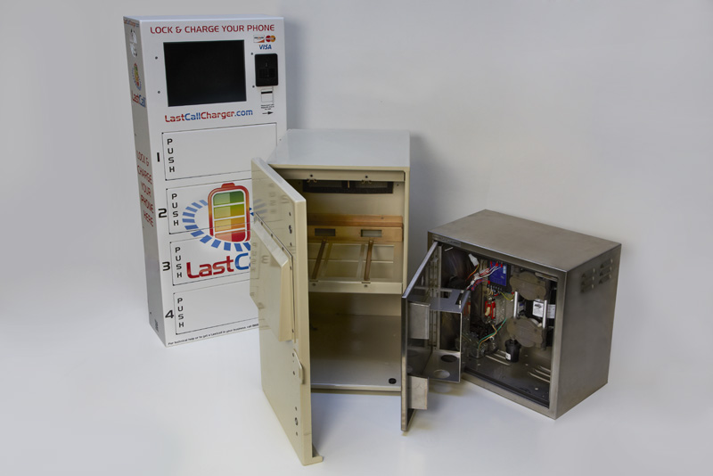
SSURANCE MANUFACTURING, INC.
Assembly Services

Slide 10
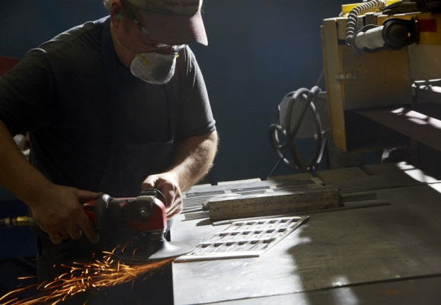
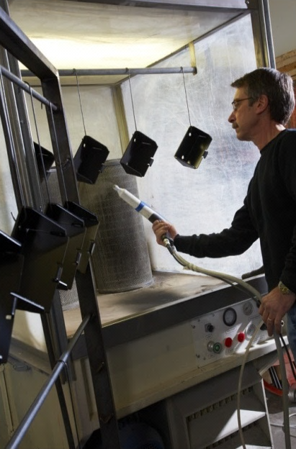
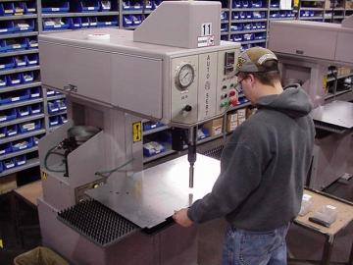
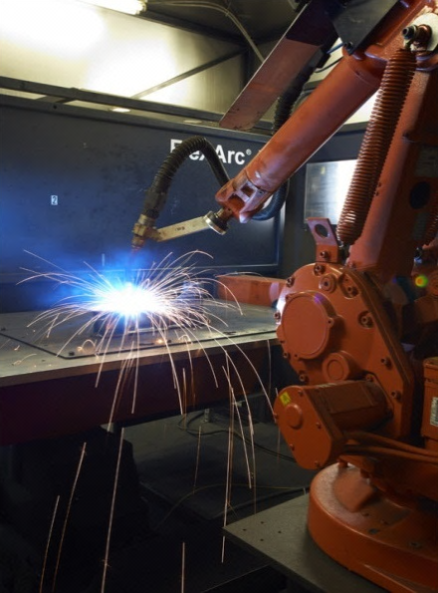
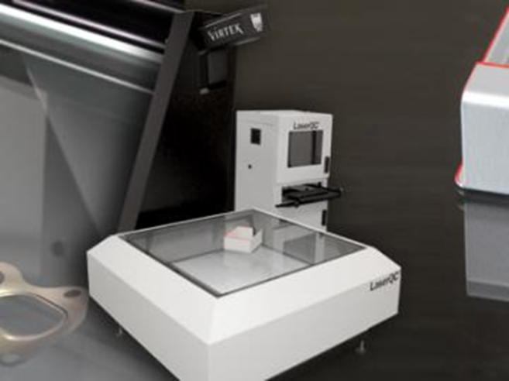
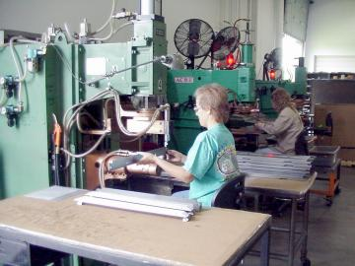
Additional Services:
  Quick Turn Prototyping
  Design Assistance
  Powder Coating
  Robotic Welding
  MIG, TIG, and Spot Welding
  Hardware Insertion
  Vibratory and Abrasive Deburring
  Cosmetic Grinding
  Laser Inspection
SSURANCE MANUFACTURING, INC.

Slide 11
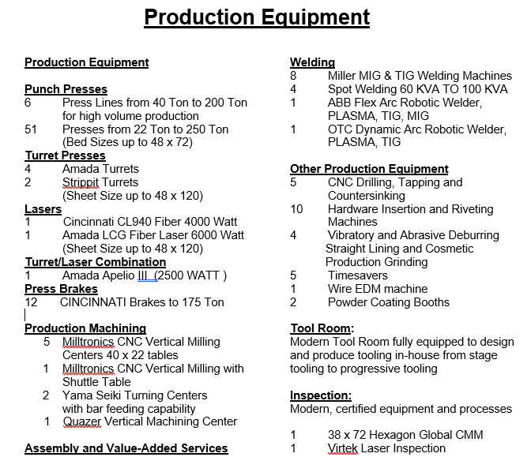
SSURANCE MANUFACTURING, INC.

Slide 12
Quality
SSURANCE MANUFACTURING, INC.

Slide 13
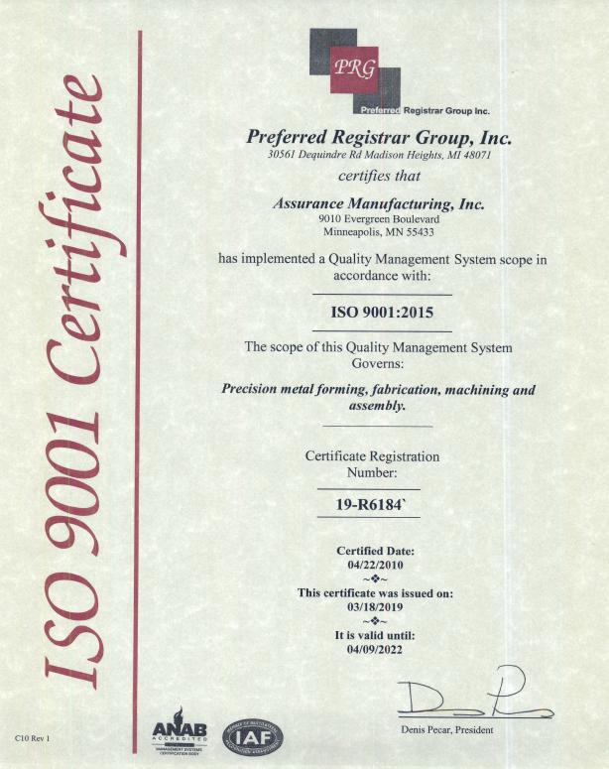
SSURANCE MANUFACTURING, INC.

Slide 14
Business Stability
SSURANCE MANUFACTURING, INC.

Slide 15
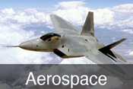

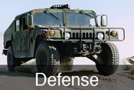
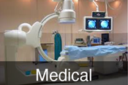

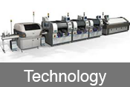
Focus on Precision markets
SSURANCE MANUFACTURING, INC.
Transportation

Slide 16
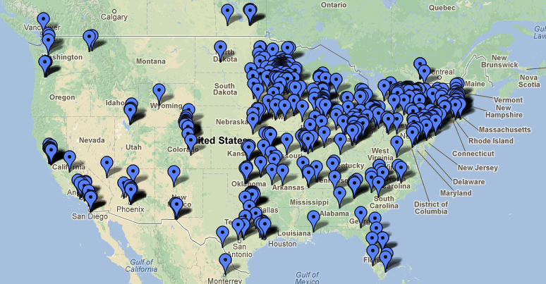
SSURANCE MANUFACTURING, INC.
Diversified Customer Base. No customer is over 8% of our business!

Slide 17

“Even though we have a Wishbone and a Funny Bone our success depends on our Backbone”
We have the financial backbone for growth!
SSURANCE MANUFACTURING, INC.
Assurance Debt/Equity is 8%/92%!
$750,000.00 spent on new equipment/year
Sales growth of 8% year over year
Low Employee Turnover
Well Diversified
Customer Focused
Pride in Quality
Continually Improving
Clean and Safe Work Environment

Slide 18
“Assurance Manufacturing, Inc. and its employees are committed to providing our customers with quality products that will meet or exceed their requirements.
This drive for excellence in quality and customer service enables us to continually improve the effectiveness of the quality management system.”
Notes:
All font on slides Arial Narrow in 22 size.

